Slide 1

Project proposal and selection process
Project: Calculator
Reason: Simple concept to showcase AGILE methodology

Slide 2

Benchmarking against current standards and examples already in production
Windows Built-in Calculator App
Calc Pro HD
Naturplay
Super Calculator 8
Sticky Calculator
Calculator+

Slide 3
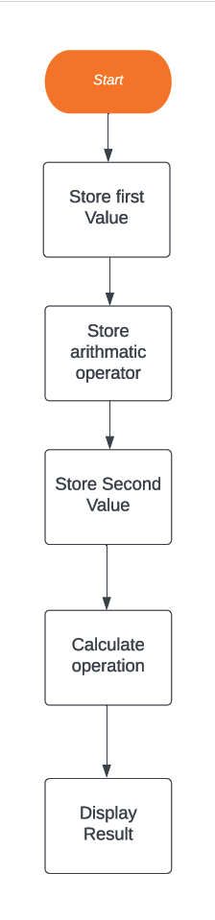

Flow Diagram

Slide 4
Prototypes and the process of development
Checkpoint 1: Project framework designed and assembled. GUI is created and labeled.
Checkpoint 2: All elements coded and tested.
Checkpoint 3: Optimization of code.

Slide 5

Areas of optimization opportunities
The Calculator needs to be optimized to handle multiple calculations.
A Redesign making it more appealing

Slide 6

Future works
In the future I plan on creating video games.

